Slide 1

Powerplant energy prediction
Mentor Name: Mr. Varun
Team Members:
1.) Mr. Naimish Wankhede
2.) Mr. Divyanshu Sharma

Slide 2
Business Objective
It seems like you're asking about the business object or purpose of a power plant energy prediction system. A power plant energy prediction system is a tool or technology used to forecast the energy output of a power plant. Its main purpose is to provide accurate and reliable predictions of how much energy a power plant is expected to generate over a specific time frame, typically ranging from a few hours to a few days ahead. This information is crucial for effective energy management, grid stability, and financial planning for power plant operators and energy market participants.

Slide 3
PROJECT ARCHITECTURE :
Collection of Data
Business Understanding
Exploratory Data Analysis(EDA)
Deployment
Model Building

Slide 4
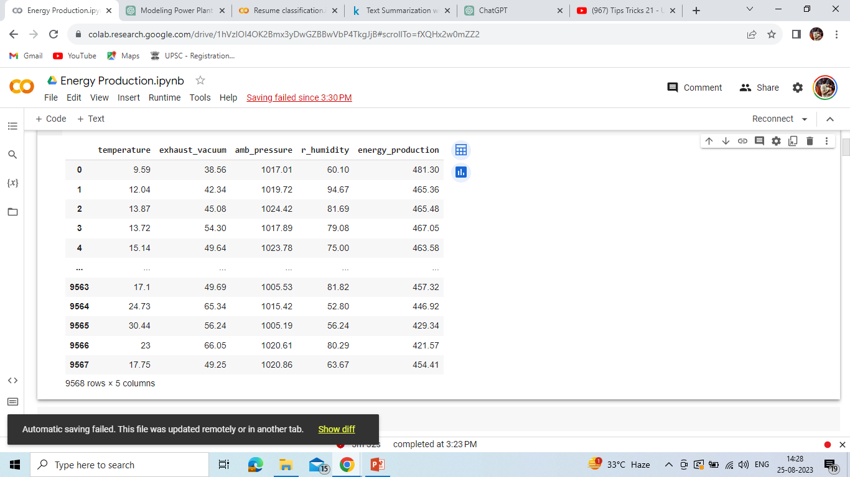
DataSets: After Extracting and Modifying the Dataset, given data contains a total of 5 Classes and 9568 rows .

Slide 5
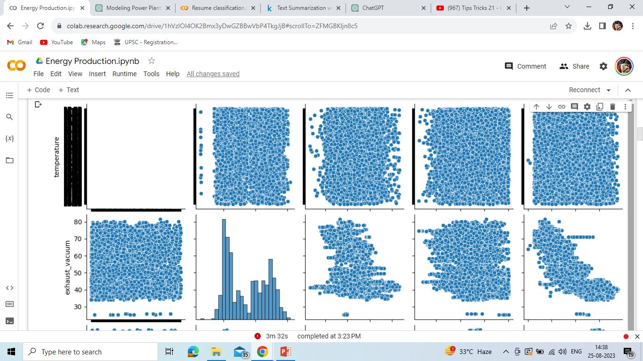
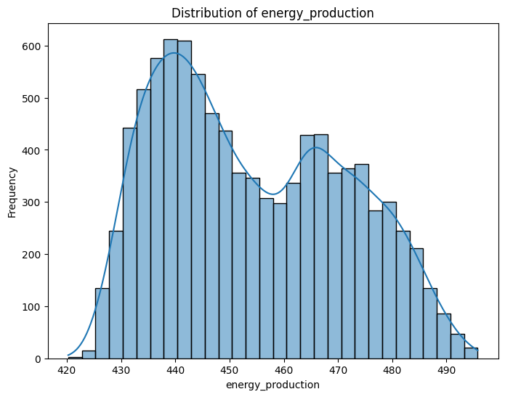
Labels :
Visualize the distribution of the target variable 'Energy Production‘.
Visualize the relationships between variables using pairplots.

Slide 6
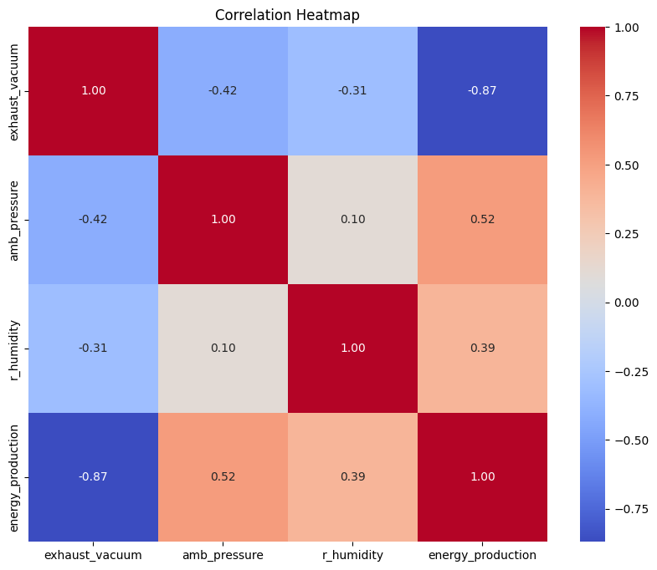
Corelation Heat map :

Slide 7
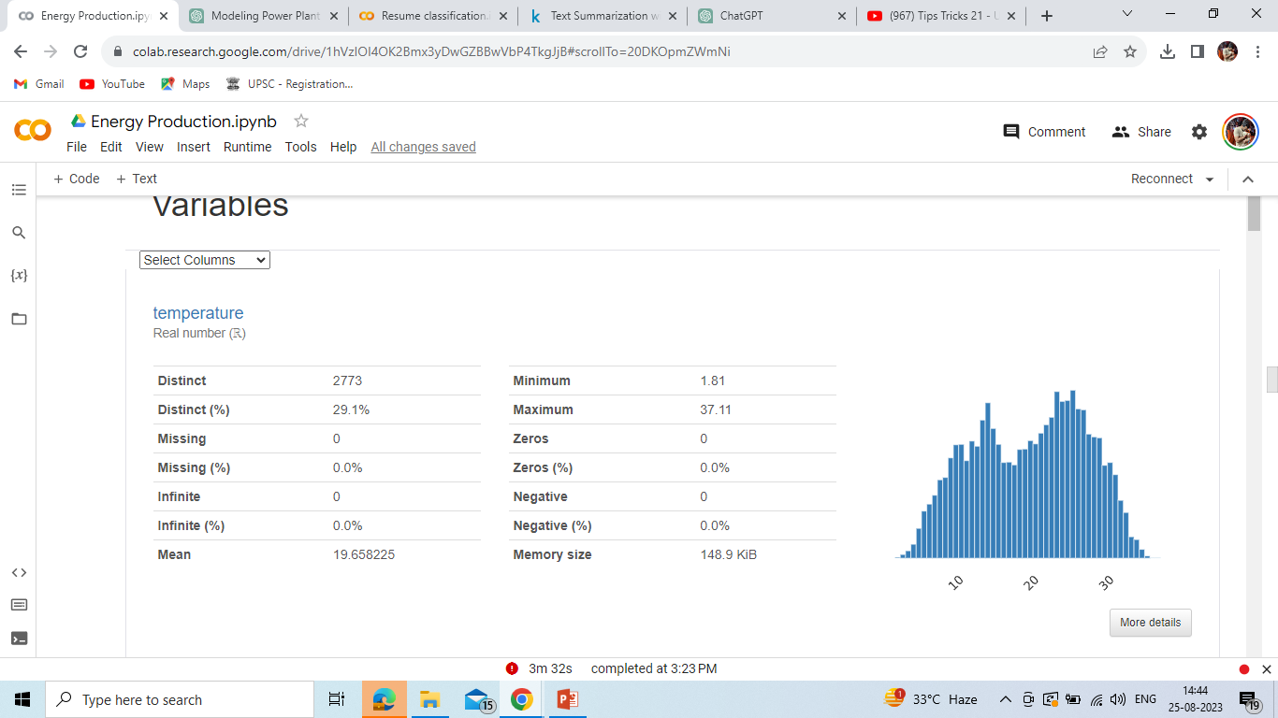
Auto eda :

Slide 8
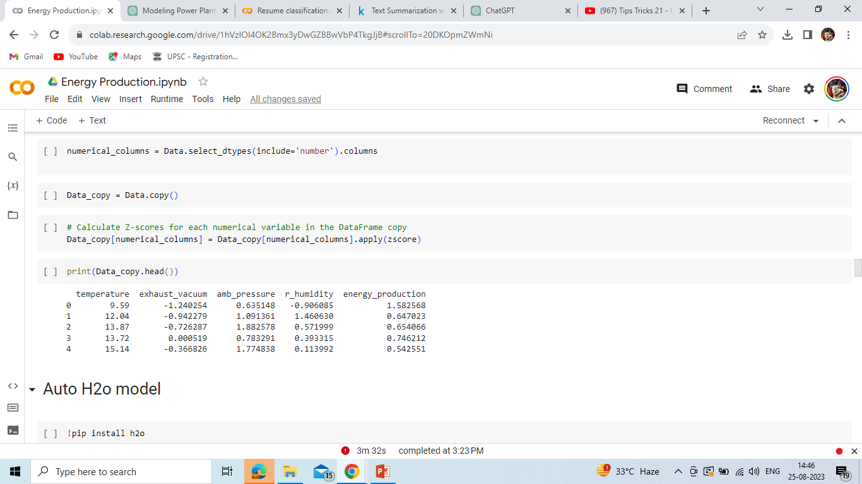
zscores :

Slide 9
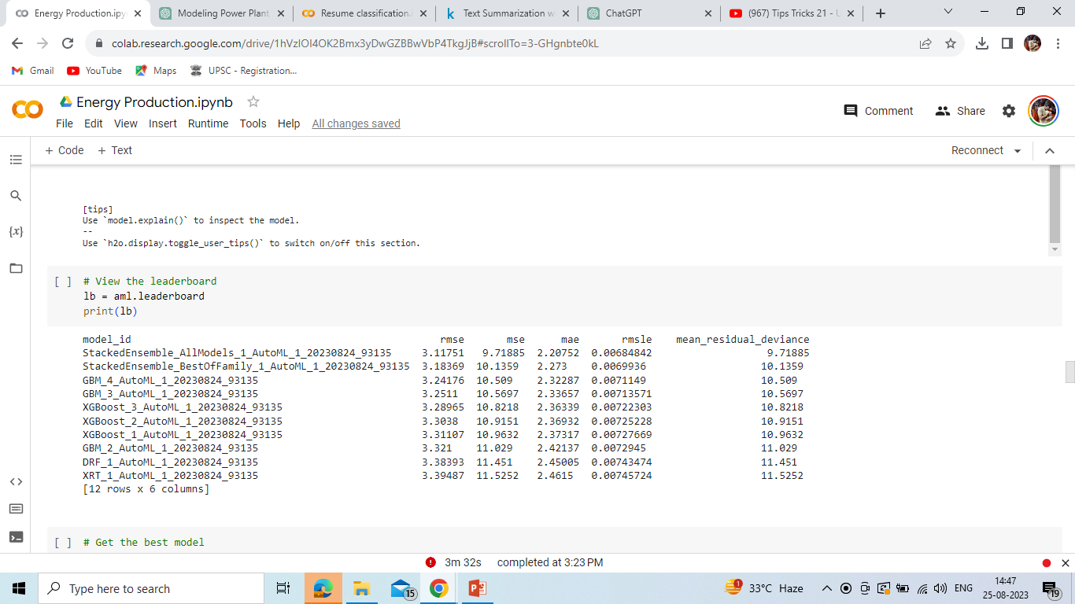
Model Building : H2O MODEL

Slide 10
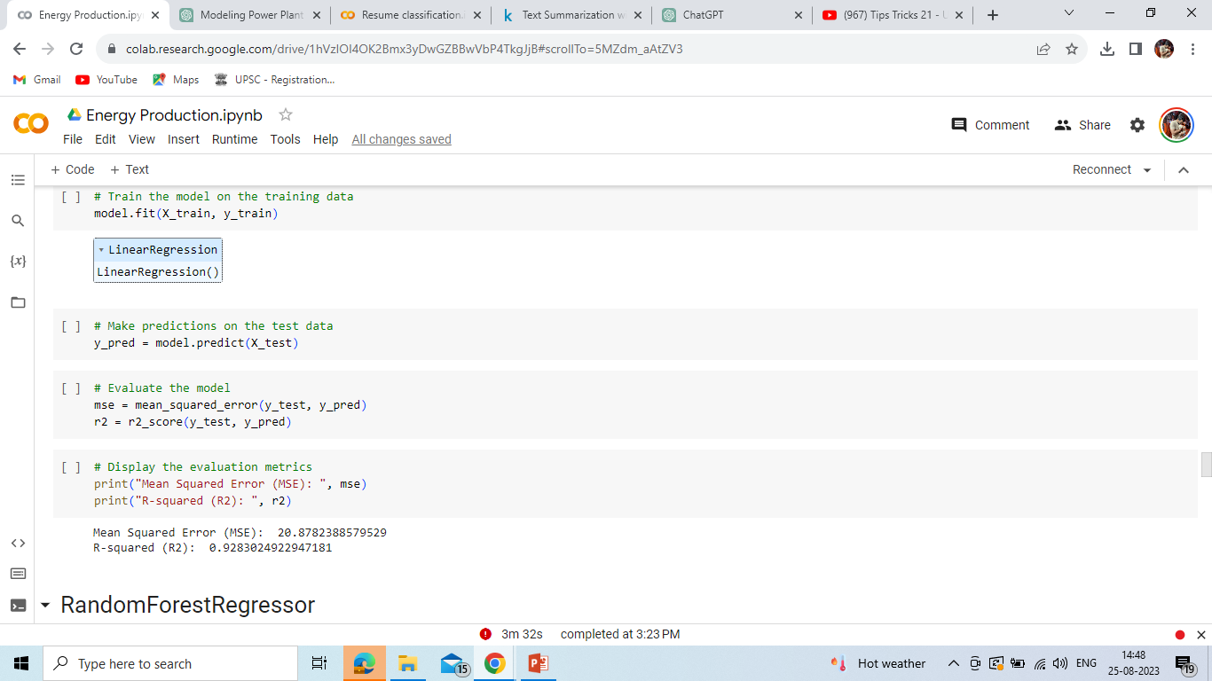
LINEAR REGRESSION :

Slide 11
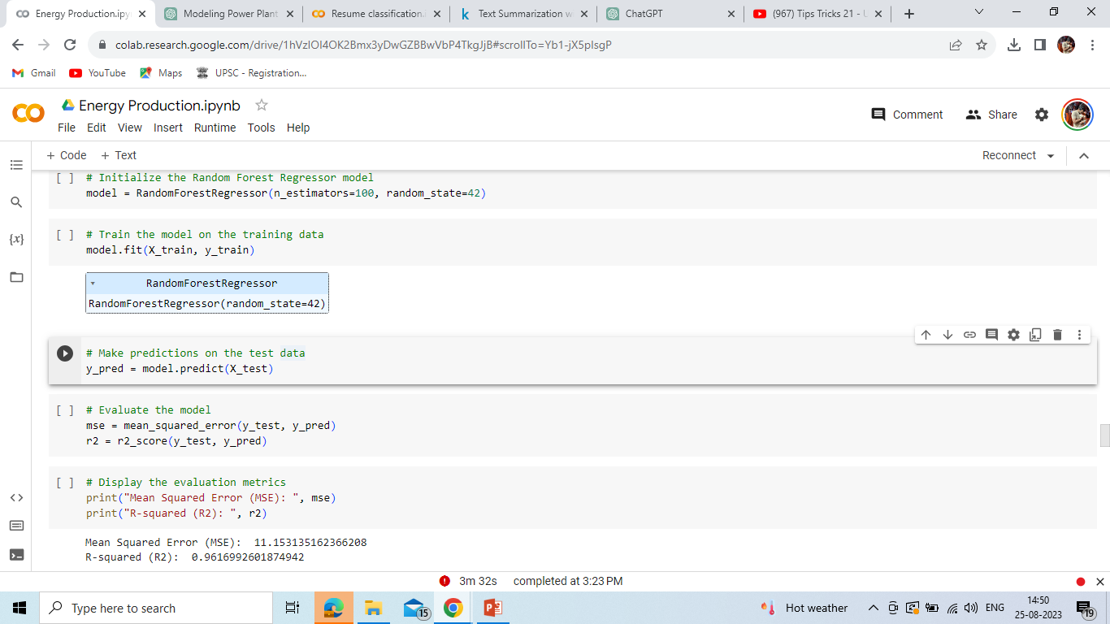
RANDOM FOREST REGRESSOR :

Slide 12
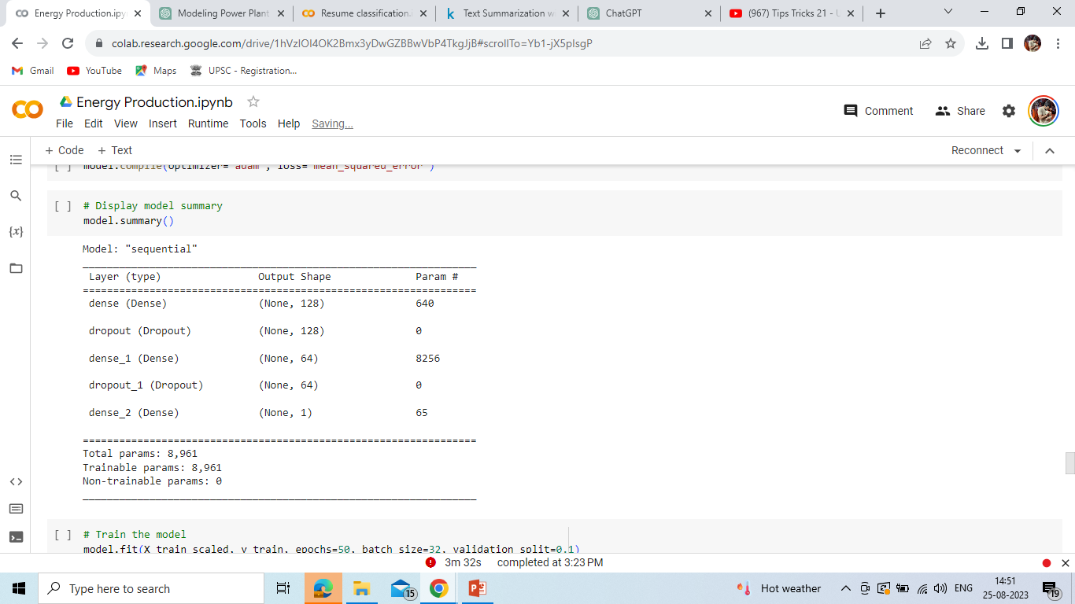
DeEP LEARNING METHOD:

Slide 13
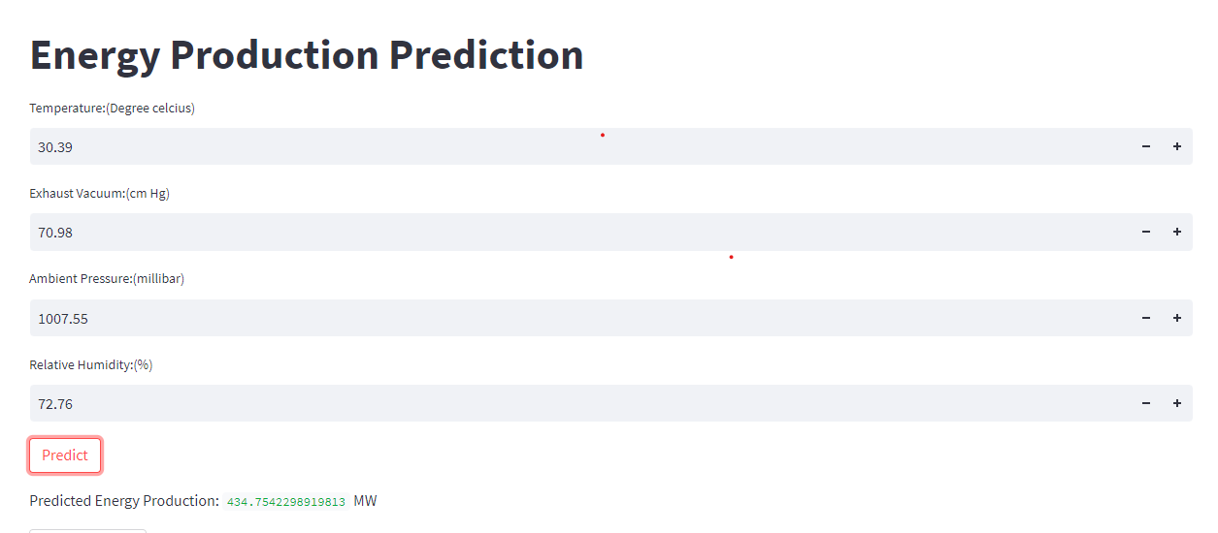
DEPLOYMENT:-

Slide 14
Thank you

